Slide 1
1 Planed
plan 1
At National Day I will finish the study of the video!!! And then have two days off for my holidays.
After it I plan to finish the project4.
4

Slide 2
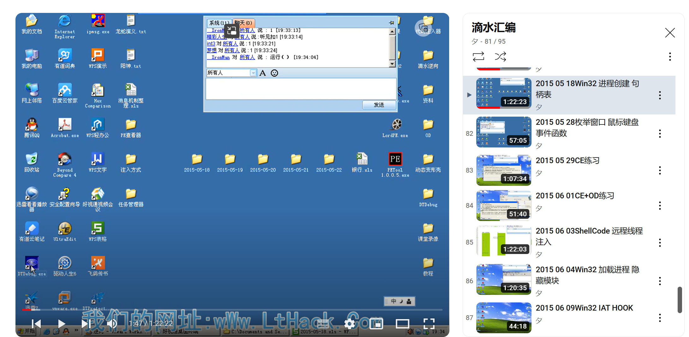
1 Results
Results 1
There is 13 classes left, mainly about the practice of CE and OD, and the hard code.
Finish the study of thread and process.
4

Slide 3
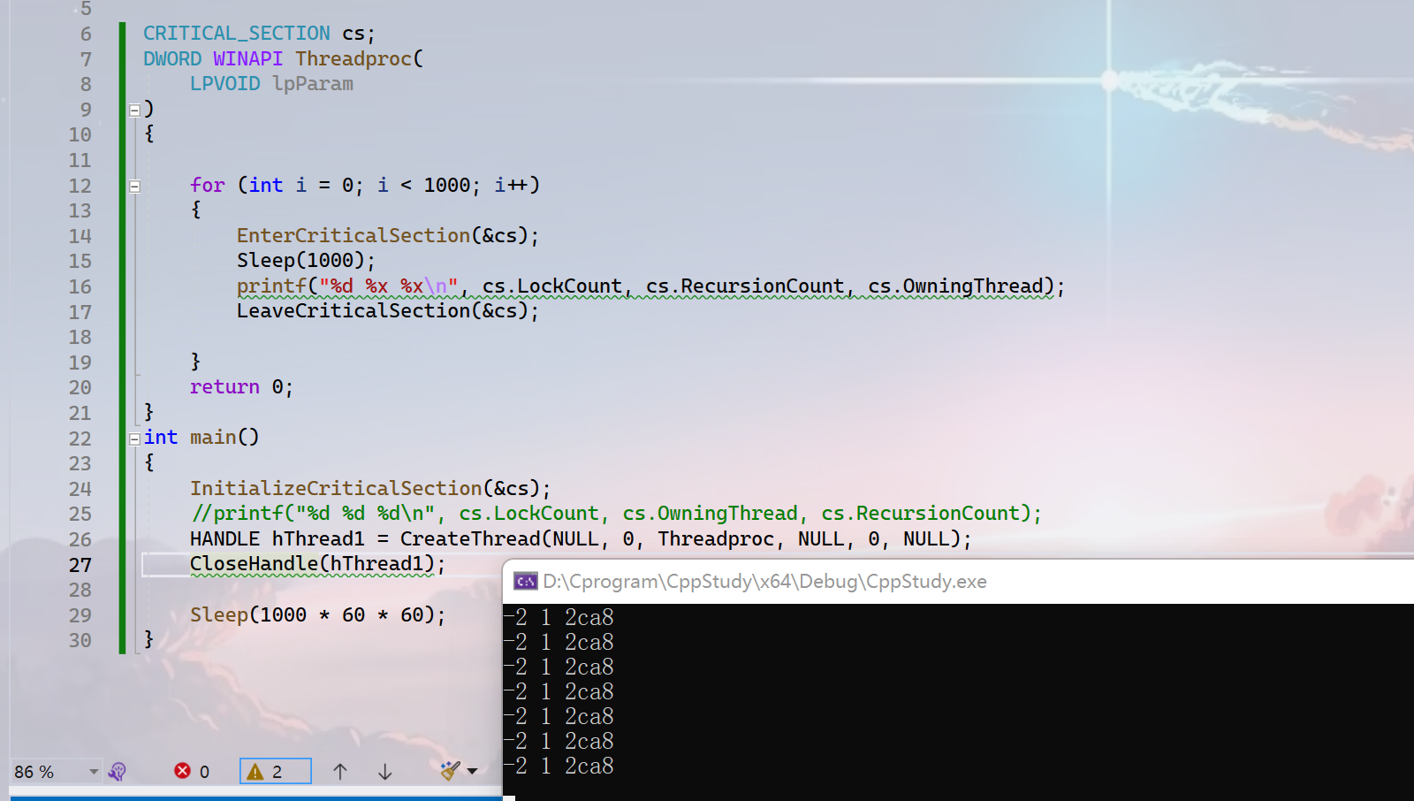
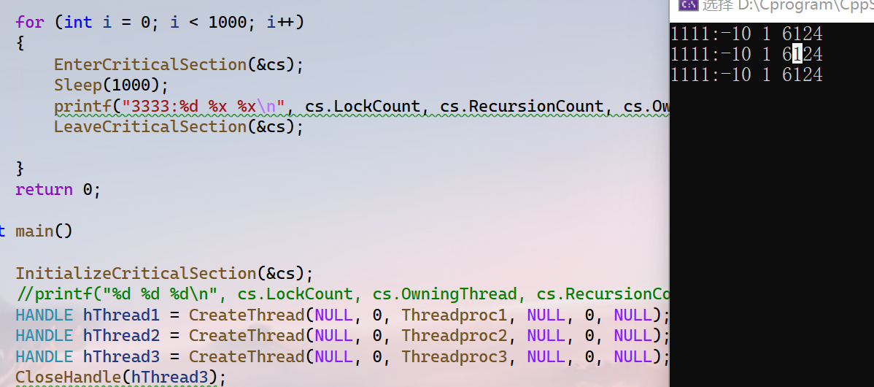
1 Challenges and Solutions
Challenges and solutions 1
In the video it said, when I enter the critical section the value of the member “LockCount”in “CRITICAL_SECTION” will change to 0 from -1. But in my test , I found the it is changed to -2 from -1, why? I found that a thread is created the value of it decrements 4.
4

Slide 4
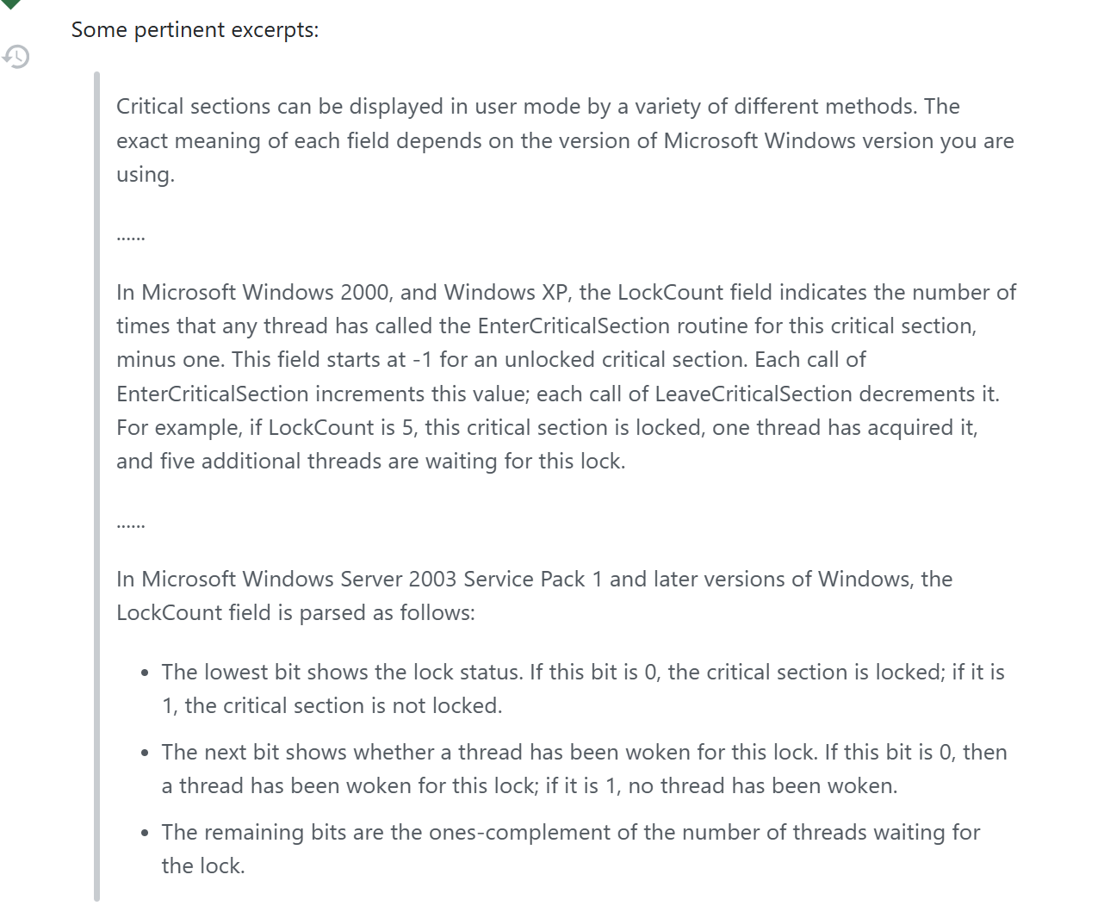
1 Challenges and Solutions
Challenges and solutions 1
c - Under what circumstances might a Windows Critical Section have a negative Lock Count? - Stack Overflow
I am a little confused about it.
4

Slide 5
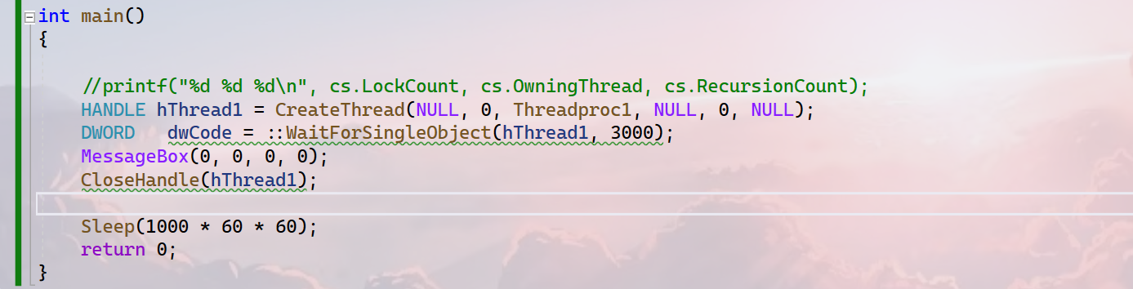
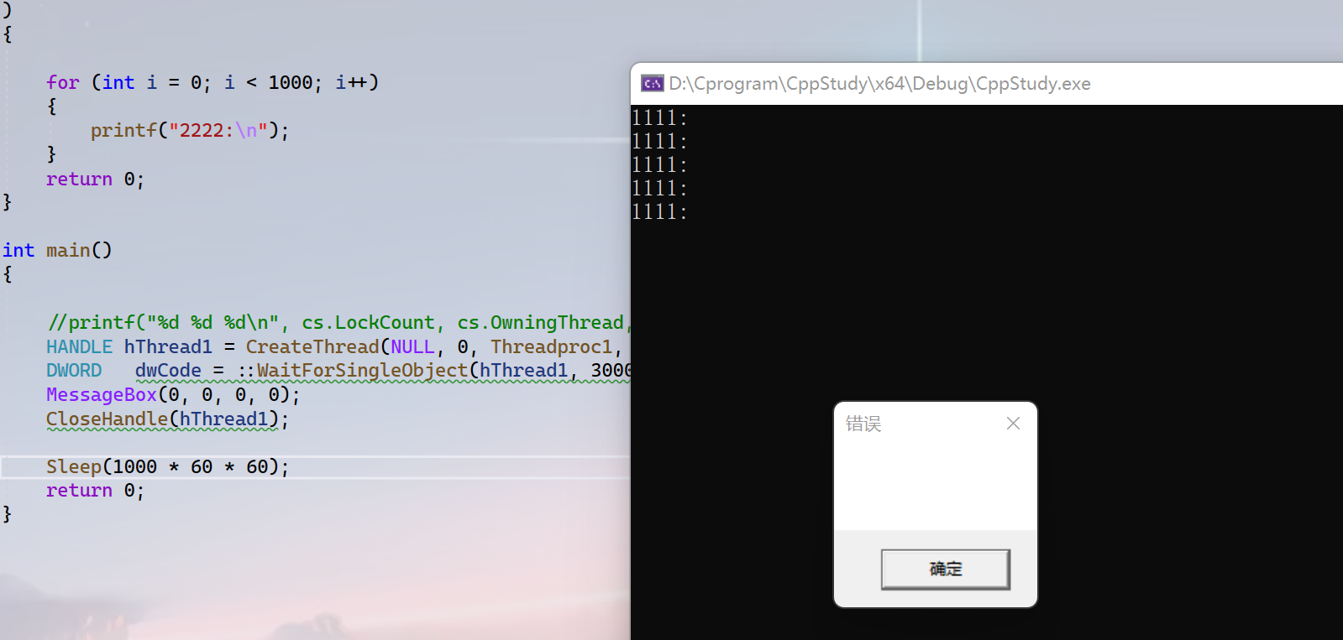
1 Challenges and Solutions
Challenges and solutions 1
Question: I suppose that the program will print three lines of `1111` and return 0. But actually print five lines of `1111`.(Sorry, the code of print`1111` I forget to provide. Just a loop to print five lines of `1111` ).
Solution: The main reason is that the function `CloseHandle` is just to close the handle of the thread but not actually close the thread.
4

Slide 6
1 Challenges and Solutions
Challenges and solutions 1
有个问题，句柄是用来维护地址的而ID内核用来维护线程或者进程的。
Question: The handle is used to preserve the address but the ID is used to preserve the thread or process?
If child process or child thread has the same ID as the parent, does it cause the accesss confict?
4

Slide 7
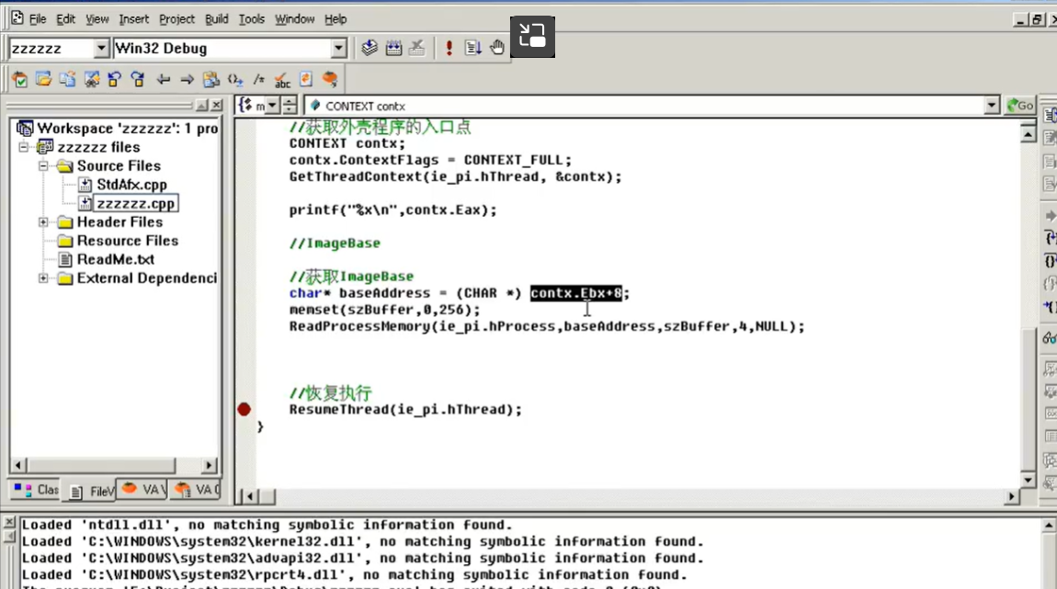
1 Challenges and Solutions
Challenges and solutions 1
I found I still have some problem about project3.
This is one of them, Why `baseAddress` is the value of `contx.Ebx + 8`.
4

Slide 8
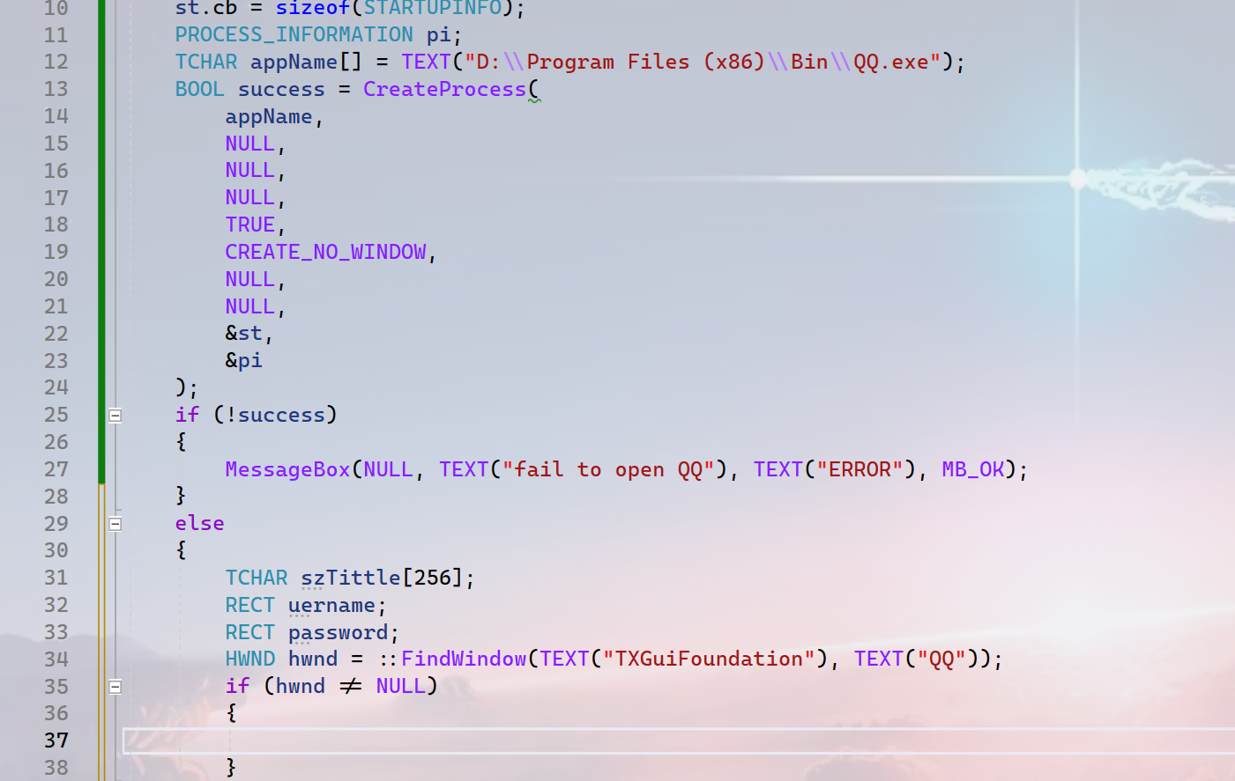
1 Challenges and Solutions
Challenges and solutions 1
This code is used to implement a function that it can login in QQ by itself. But there is a problem that I have no idea to find the ID of the`Edit` of `username` and `password`. I can not find the `.rc` file of QQ.
4

Slide 9
1 Plan
plan 1
There are some tests in the video and 13 classes left, plan to finish them before next meeting.
The code comments! Aaaaa, I suddenly find that I have a lot of things to do.[sad,sad,sad].
4

